Slide 1
Building a better APUSH DBQ
By,
Nathan Wendt
Carnegie Vanguard High School
1501 Taft Street
Houston, TX 77019

Slide 2
What you need
Your phone (briefly)
A few sheets of paper for notes
1 sheet of paper for writing (what your turning in)

Slide 3
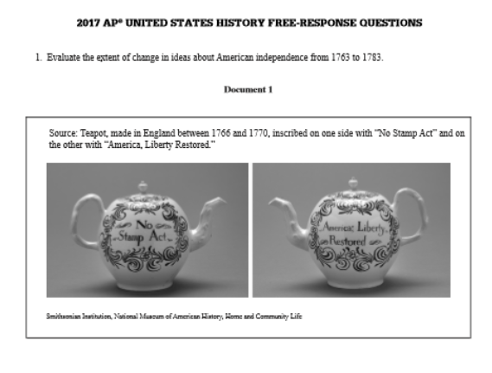
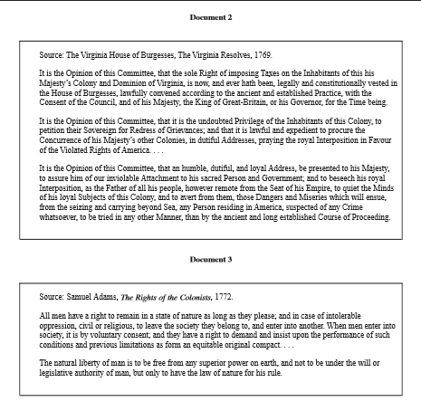
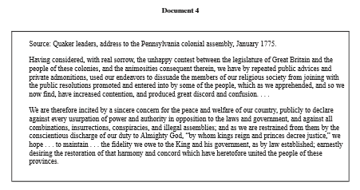
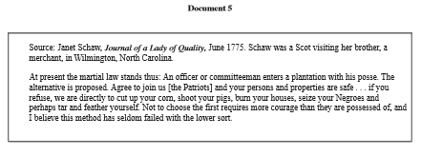
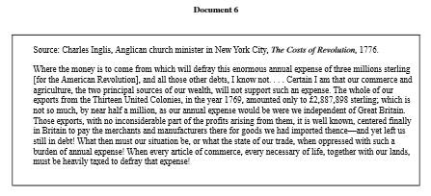
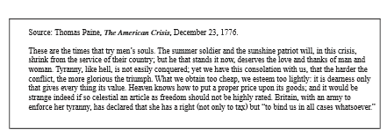
SEVEN DOCUMENTS TOTAL

Slide 4
The prompt
“Evaluate the causes that have influenced your mood today.”

Slide 5
Pre-write your answer
Notice we have no documents yet!
Answer with your own knowledge
What is your mood?
What caused it?
This is your initial argument
Cause #1 + Cause #2 + Cause #3 have influenced my mood today
Cause #1
Cause #2
Your Mood Today
Cause #3

Slide 6
Document Discussion
What is a primary source? A secondary source?
In an essay how would you use
Pictures? Graphs? Maps? Or written words?
What could you support with them?

Slide 7
Document creation
In one minute (60 seconds) you need to
Take a selfie
Take a pic of somebody at your table and email/text/snapchat it to them
In two minutes (120 seconds) you need to
Make a written statement that deals with the prompt
Make a written statement about somebody else's day at your table and give it to them
Now you should have 4 documents
Selfie is Doc A
Pic of you is Doc B
Your statement is Doc C
Statement about you is Doc D

Slide 8
Document input to your initial argument
Guiding questions for each document
“How would you use these documents to support your argument”
“Do any documents contradict or corroborate?”
With your prewrite chart note what document should go where
Cause #1
Cause #2
Your Mood Today
Cause #3

Slide 9
Use of Documents Vs. Sourcing Documents
Using documents is important because the essay is called the DBQ, and you can only get like two out of seven points with out them.
You need documents to
Substantiate your argument
Get document usage point (use 6 of 7 documents)
The Three Document Points
Basic Usage- You demonstrate that you understand three of the seven documents (no argument needed)
Usage + Argument- You use 6 out of 7 documents AND you connect them to your argument
Extended Document Analysis- You use HIPP for 3 of the 7 documents correctly AND connect that extended analysis to your argument.

Slide 10
What is HIPP?
Extended Analysis is important because it shows the reader that you are not a machine, and you are indeed a human (that has skills)
H.I.P.P. (the only acronym you need for essays in this class) for 4 documents for 1 point
Historical Context – What event or era was the document created in & significance.
Intended audience – What specific group of people was this document created for/impact on its message & significance.
Purpose – What was the authors intent for creating this document (i.e. what action does s/he want the reader to take?) & significance.
Point of View – How does who the author is impact at the particular time of the document’s creation impact what they are saying? & significance

Slide 11
Doc. Usage Sentence Stem Practice
On your notes paper
Document (_) says/shows ____(your description)__________.
Document usage
____(Your description)__ is important to the argument of __(the cause #)__ because of __(significance)___.
First and Second document point
The __(H.I.P.P. Category)__ of Document (_) is ________________, which is significant because of ____________.
document sourcing point
These sentence stems are the easiest way that you can make clear to the reader what they are looking at and it includes what you need for the respective points.

Slide 12
Outside information & proper use
Guiding question – “What are some proper nouns, NOT included in the documents OR used in your document sourcing that could help your argument?”
Create a list of these proper nouns, with a brief definition and significance
Input them into this sentence stem
Additional evidence that supports __(Cause #)__ is _(outside info + brief definition)_ because of _(significance)_.

Slide 13
Single topic paragraph construction
Introduce Cause#
__(Cause)__ significantly effected my _(Mood)_ today.
Filled in document sentence stems
Document (_) says/shows ____(your description)__________.
____(Your description)__ is important to the argument of __(the cause #)__ because of __(significance)___.
The __(H.I.P.P. Category)__ of Document (_) is ________________, which is significant because of ____________.
Outside evidence sentence stems
Additional evidence that supports __(Cause #)__ is _(outside info + brief definition)_ because of _(significance)_.
Put this aside for we will add to it later

Slide 14
Introduction to Contextualization
In addition to using the documents, you need to show mastery of certain historical thinking skills one of which is Context (1 point)
Guiding question - “What other factors/events were going on during this time period that affects the topic/argument?”
This is 2-3 sentences in your introduction before your thesis.
Post-Context- 2-3 sentences in your conclusion that discuss events immediately after the concept in question.

Slide 15
Putting it all together
Construct your essay in this order
Context (big picture)
Thesis (Causes + Mood + time period)
Cause #1 paragraph
Cause #2 paragraph
Cause #3 paragraph
Complexity paragraph
Restatement of thesis (topic sentences + prompt stem)

Slide 16
Final Point- Complexity
“Demonstrates a complex understanding of the historical development that is the focus of the prompt, using evidence to corroborate, qualify, or modify an argument that addresses the question”
What can you do? Three easiest ways…
Analyzing multiple variables- is one cause greater than others? Are you explaining why?
Similarity/Difference, Cause/Effect, Continuity/Change (if a question is asking for just one, you are explaining both.
MEANINGFUL connections across time periods

Slide 17
Synthesis
The other historical thinking skill you need to demonstrate mastery of is Synthesis
Synthesis can be a lot of things, but basically it is an opportunity for you to show your understanding of history and almost an evolution of your thesis
Synthesis points can be given for
Comparison to another historical event (outside of the time period)
“My mood was similar to another day…”
Connecting or Extending your argument to another time period
“My mood would influence my mood tomorrow…”
Introducing another topic not mentioned in the prompt
“In addition to my mood, my hair style…”
Connecting your topic to a different geographic region (can be same time period)
“Because of _(significant event)_ people in (region) had moods that are similar to mine…”

Slide 18
Synthesis continued
Different types of synthesis may be easier depending on the prompt / historical thinking skill essay type
Can be / will be awarded points for
Cannot be / no points
Demonstrating a clear connection to the reader
Located anywhere in the essay*
Just a simple statement, we need to know you get it
*except for the thesis

Slide 19
Synthesis continued
Because of this prompt the easiest way to get synthesis would be to compare it to another day in which you had a similar mood created by similar causes
Create a Venn diagram on your notes paper and identify 3 similarities
Sentence stems
“In addition to (my mood) today, similar circumstances can be found in (my mood) on (this day)”
(Cause #1) is similar to (Synthesis Cause #1) because of ____ which is significant because of ___.
In addition to that (Cause #2) is similar to (Synthesis Cause #2) because of ____ which is significant because of ___.
Lastly (Cause #3) is similar to (Synthesis Cause #3) because of ____ which is significant because of ___.

